Slide 1

VISUAL IMPAIRMENT (BLINDNESS)

Slide 2

LOW VISION

Slide 3
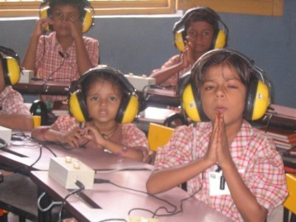
HEARING IMPAIRED

Slide 4

SPEECH IMPAIRED

Slide 5
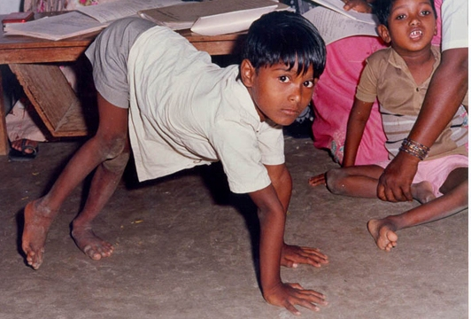
LOCOMOTOR IMPAIRED

Slide 6
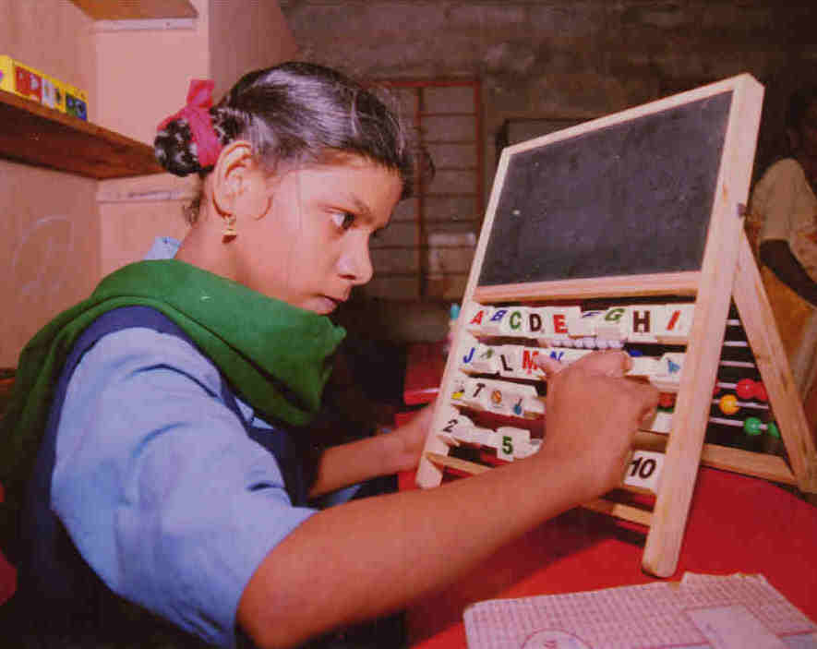
MENTAL RETARDED

Slide 7

LEARNING DISABLED

Slide 8
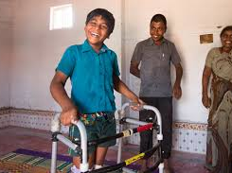
CEREBRAL PALSY

Slide 9

AUTISM

Slide 10
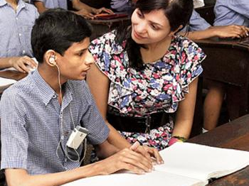
MULTIPLE DISABLED

Slide 11
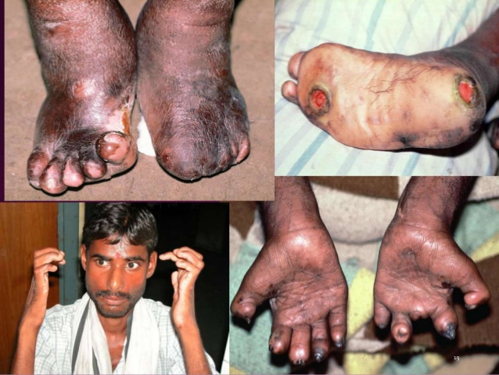
LEPROSY CURED PERSONS

Slide 12

DWARFISM

Slide 13

CHRONIC NUROLOGICAL CONDITION

Slide 14
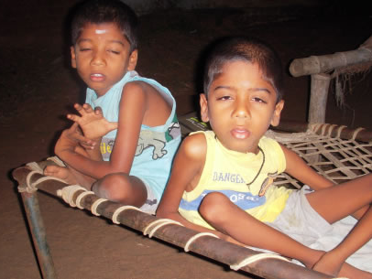
MUSCULAR DYSTROPHY

Slide 15

MULTIPLE SCLEROSIS

Slide 16

MENTAL ILLNESS

Slide 17
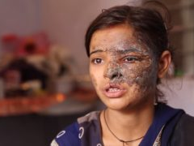
ACID ATTACK VICTIMS

Slide 18
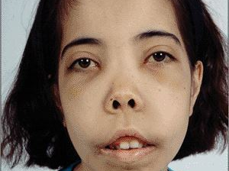
THALASSEMIA

Slide 19

HEMOPHILIA

Slide 20
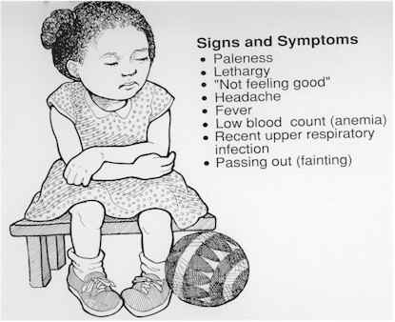
SICKLE CELL DISEASE

Slide 21
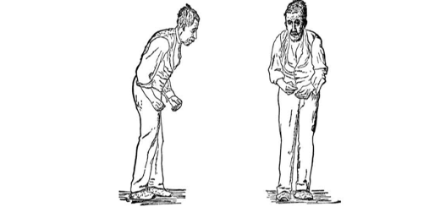
PARKINSONS’S DISEASE

